Slide 1
Williams Olefin Plant Explosion
BY
S.SIVARANJINI
J.B.MATHANGI
N.KUZHALI

Slide 2
INTRODUCTION
The Williams Olefins Plant is a large petrochemical plant spread over an industrial area 20 miles (32 km)located in Geismar, Louisiana.
The plant produces 40,000 tons of propylene and 650,000 tons of ethylene every year for use in the plastics industry.
The explosion happened at the Williams Olefins Plant on Thursday, June 13, 2013.
The propylene combustion at the site resulted in two fatalities and 77 injuries.

Slide 3
Geismar Chemical Explosion
The Williams Olefins Plant explosion occurred on June 13 and this explosion is said to be triggered by the "catastrophic" failure of a heat exchanger.
Two workers were killed and 77 injured.
The U.S. Occupational Safety and Health Administration (OSHA) and the U.S. Chemical Safety and Hazard Investigation Board (CSB) launched investigations to determine how and why the heat exchanger failed.
The combination of the flammable gas and an ignition source could cause a major explosion

Slide 4
PRIOR LEAK INCIDENT
On December 18, 2012 workers discovered "a visible leak" of propylene gas. According to a report submitted by Williams Olefins to the Louisiana Department of Environmental Quality (DEQ),514 pounds (233 kg) of propylene gas escaped.
Williams Olefins said: "Piping corrosion under insulation is believed to be a significant factor in this incident. This was a small isolated corrosion location that had not been previously found”.
The Times-Picayune of New Orleans reported that there had been leaks of 100 pounds (45 kg) each of ethylene and volatile organic compounds in 2010; 93 pounds (42 kg) of benzene in 2009; and 4,000 pounds (1,800 kg) of propylene in 2008.

Slide 5
Timeline for the series of events
on June 13
at 8:37 a.m – the catastropic explosion occurred.
At 8:39 a.m - plant officials notified State Police.
at 8:43 a.m - Parish emergency officials were notified.
at 8:47 a.m - Parish emergency managers took charge.
Till noon - The chemical releases included liquids and gases continued.
until about 4:30 p.m - gases and particles were released from flares.

Slide 6
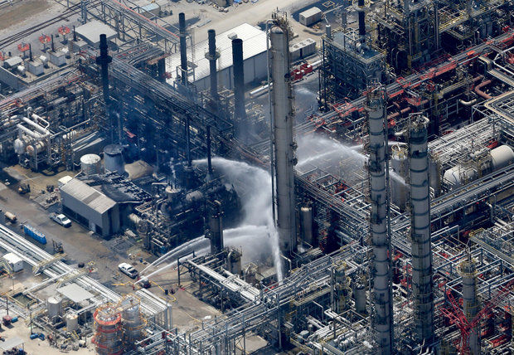
Williams Olefins plant site near Geismar on Thursday, June 13, after a fire and explosion killed 2 workers and resulted in the hospitalization of 114 others

Slide 7
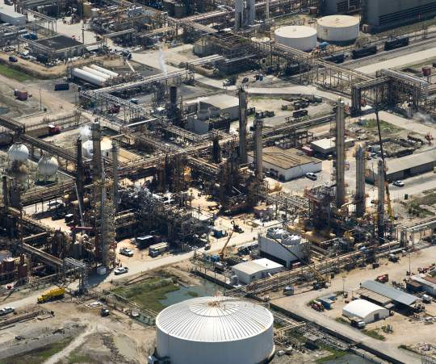

Slide 8
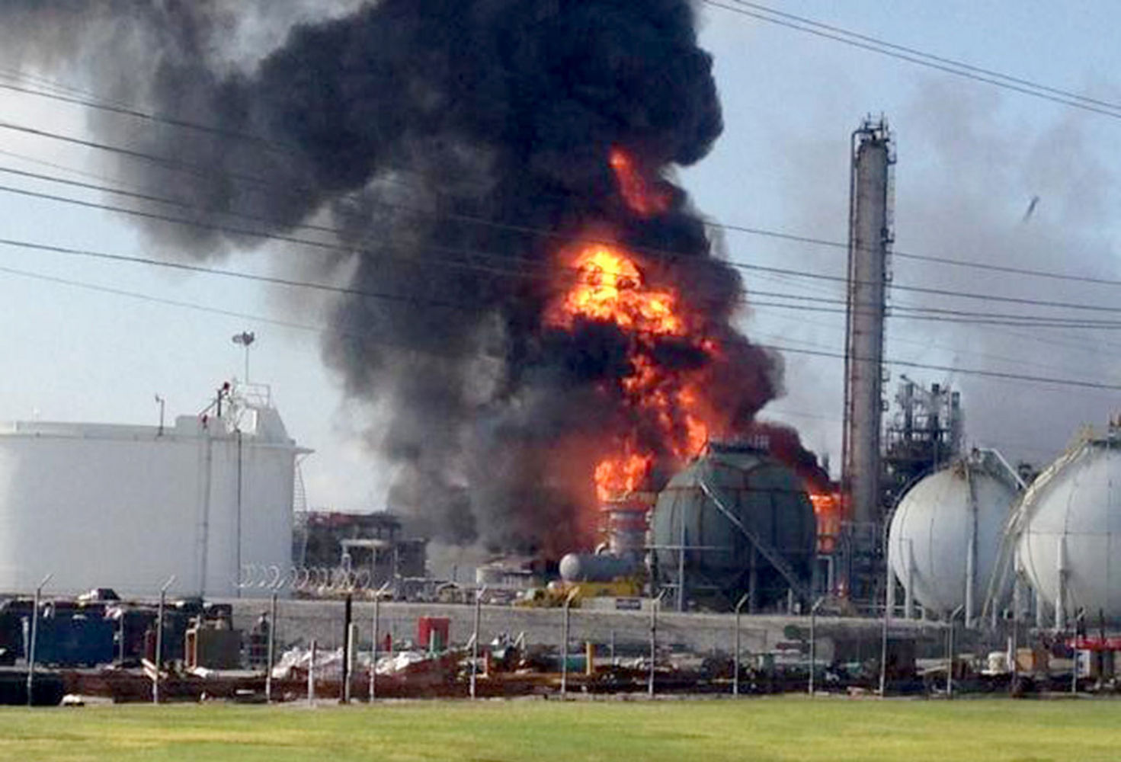

Slide 9
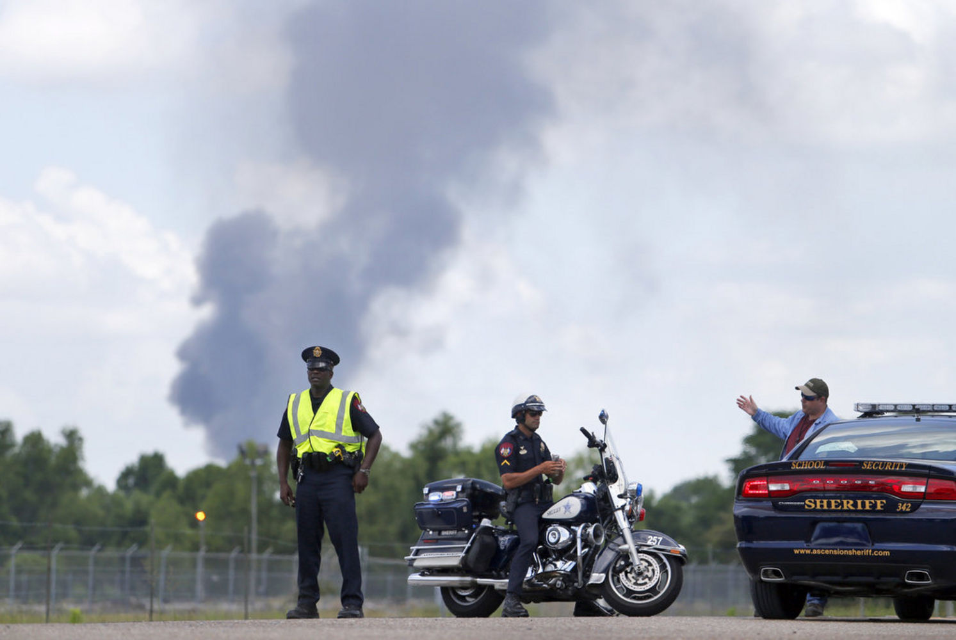

Slide 10
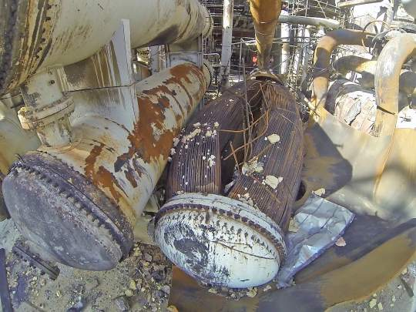
Post-blast photograph of the heat exchanger which ruptured catastrophically,causing extensive explosion & fire damage to plant.

Slide 11
Chemical Process Description
The Williams Olefins Plant is a petrochemical plant which produces ethylene, propylene and other products through steam cracking of ethane and propane.
This process uses high temperatures to break long chain hydrocarbons into shorter chain olefins.
The ethane is diluted with steam and briefly heated in a furnace without the presence of oxygen.
Typical reaction temperatures are very high, at around 1,560 °F (850 °C), but the reaction is only allowed to take place very briefly.
After the cracking temperature has been reached, the gas is quickly quenched in the heat exchanger to stop the reaction.

Slide 12
Reasons for Explosion
A rupture in an off-line reboiler is responsible for causing an explosion at a Geismar plant that killed two people, investigators concluded.
According to the preliminary findings, there were three main factors that contributed to the massive explosion.
The unexpected presence of liquid hydrocarbons in the reboiler in standby mode
The introduction of heat into this standby reboiler
The pressure relief system was isolated from the reboiler which was in standby mode
When the standby reboiler ruptured, a vapor cloud was released, then ignited by an unknown source.

Slide 13
Additional factors that contributed to the explosion
On Dec. 18, workers attempting to repair a valve on the pipe discovered "a visible leak" of the highly flammable gas and notified facility control room
According to the report, 514 pounds of the gas escaped, which was not enough to be considered a violation of the plant's air pollution permit, which allows "fugitive emissions" of 197.84 tons of volatile organic carbon materials a year.
Piping corrosion under insulation is believed to be a significant factor in this incident.
Lack of preventive maintenance
Careless or improper operation or operator error.

Slide 14
Aftermath
Emergency responders were notified and shut-down valves were closed after the explosion, isolating the unit, according to a release.
Emergency responders took 73 people to hospital
Some 300 workers from the plant were evacuated and all the employees were accounted for, among them 10 who stayed behind in a safe room inside the plant
Plant operations were shut, and the company's own emergency response crews were assisting at the scene.
That "shelter in place" order was later lifted for residents but remained in effect for four other plants in the area that scaled down their operations

Slide 15
Chemicals Released During the Explosion
According to the report, the facility released 31,187 pounds of volatile organic carbon material, including 23,090 pounds of propylene; 2,398 pounds of ethylene; 5,621 pounds of other volatile organic carbon materials, including propane; and 48 pounds of benzene.
Also released were 85 pounds of soot and particulate matter. The report said those are conservative estimates.
A form contained in the Williams Olefins report to LDEQ listed the chemicals released as both total volatile organics and as individual chemicals.

Slide 16
Health problems
24 people who reported health problems after the accident, ranging from respiratory and eye irritations to headaches and nausea.
Some water used to fight the chemical fire was captured in tanks or holding areas on site, according to the report, but some of that water left the plant site in storm drains or as sheet flow across the property.
wastewater releases may have violated the company's permits for discharge of wastewater, including for benzene, ethylbenzene and toluene.

Slide 17
Damages to the company
Also damaged were electrical cable trays in elevated parts of a pipe rack, which will require the replacement of “significant amounts of the electrical power cable and control wiring in the plant”
A 50-foot section of pipe rack that includes part of the plant’s steam system also will need replacing, the release said.
The piping, heat exchangers and reboilers in the area just adjacent to the propylene fractionator have been seriously damaged and will likely need to be replaced

Slide 18
Lessons Learnt
Proper equipment design and preventive maintenance measures should be followed
All safety valves must be checked periodically and any isolation or malfunctioning should be quickly identified.
Piping corrosion must be dealt in serious and any possible leak should be rightly identified.
All reactors must be emptied and freed from Flammable liquids and gases to prevent retainment during standby mode. Purging must be followed.
Metallurgical and mechanical testing of equipments must be done to determine the strength and life of the equipments and reactors.

